Slide 1


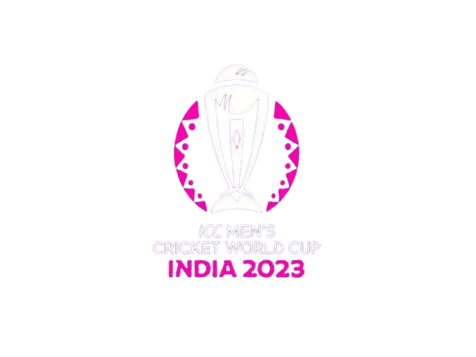



ANALYSIS
Data Source: Kaggle
Technologies Used: Python
Data Cleaning: Pandas, Numpy
Visualization: Matplotlib, Seaborn
© Project made & presented by: Krrish Madaan

Slide 2




Objective: To analyze ball-by-ball data of the CWC 2023 tournament to find crucial trends and insights of the tournament
Key Insights: Batting trends, bowling efficiencies, team performances, and dismissal patterns.
Visualizations: Heatmaps, bar charts, pie charts, and scatter plots to highlight critical trends.
KPIs Explored: Dot ball analysis, batting consistency, team extras, innings comparisons, dismissal breakdowns, and a lot more. Stay tuned with the presentation to explore the detailed KPIs.
Technologies Used: Python (Pandas, Numpy, Matplotlib, Seaborn).
GitHub Repository with the ipynb file: https://github.com/krrishmadaan5/icc_cwc_2023_analytics
LinkedIn Profile: https://www.linkedin.com/in/krrish-madaan-264968231/
Portfolio: https://sites.google.com/view/krrishmadaan
E-mail: madaank023@gmail.com
PROJECT OVERVIEW
© Project made & presented by: Krrish Madaan

Slide 3
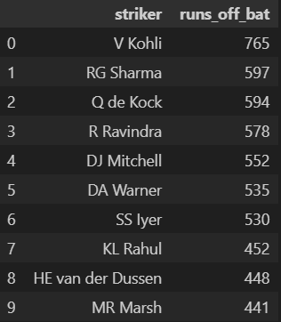
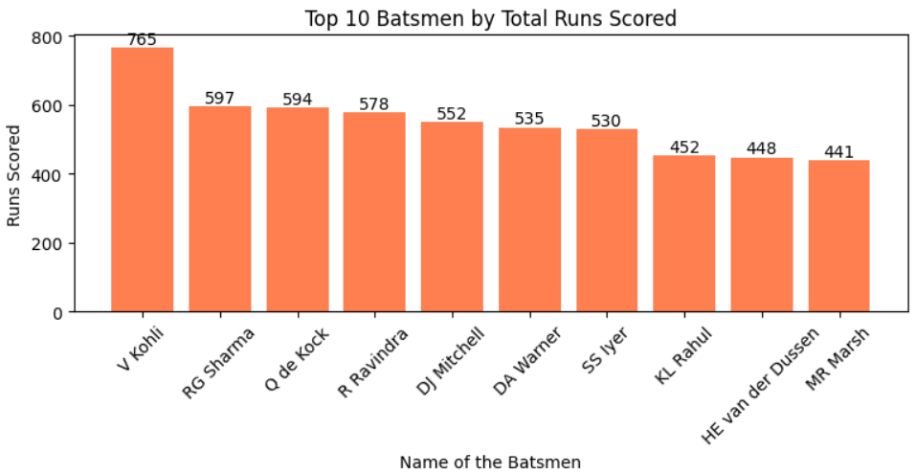
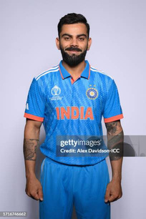
TOP 10 BATSMEN BY TOTAL RUNS SCORED
Analysis: Virat Kohli scored the maximum runs in the tournament (765).
© Project made & presented by: Krrish Madaan

Slide 4
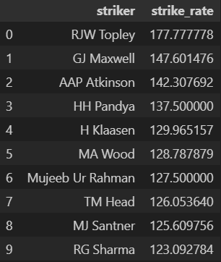
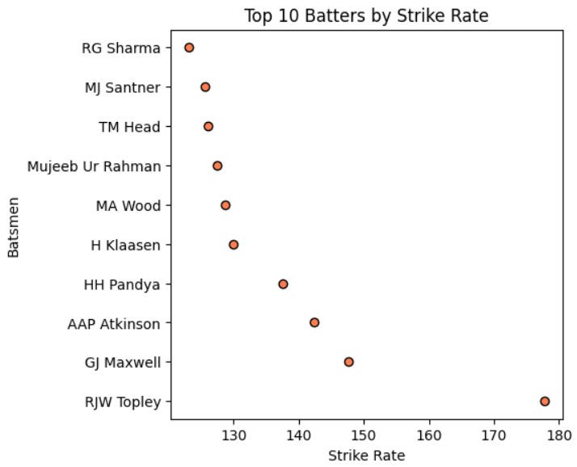
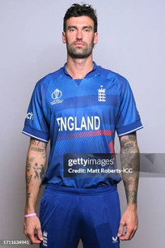
TOP 10 BATSMEN BY STRIKE RATE
Analysis: Reece Topely had the maximum batting S/R in the tournament (177.78)
© Project made & presented by: Krrish Madaan

Slide 5
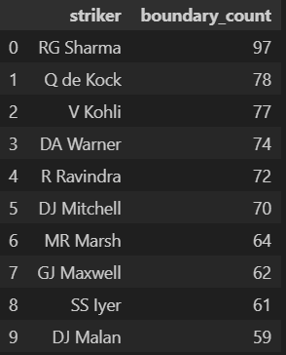
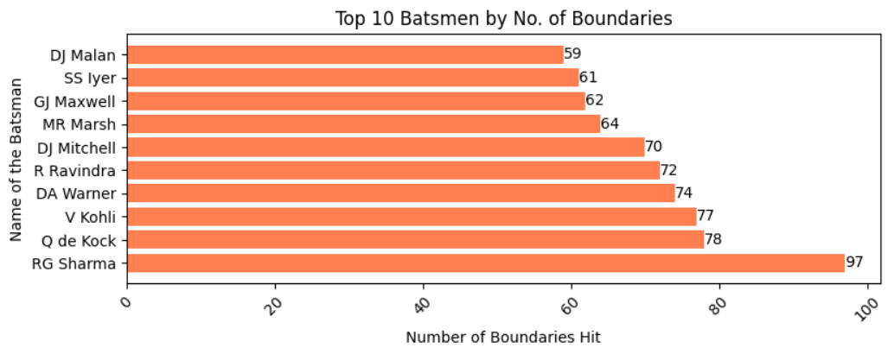
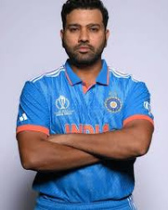
TOP 10 BATSMEN BY BOUNDARIES HIT
Analysis: Rohit Sharma hit the maximum boundaries in the tournament (97).
© Project made & presented by: Krrish Madaan

Slide 6
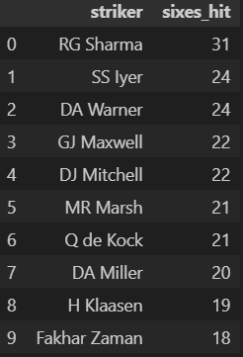
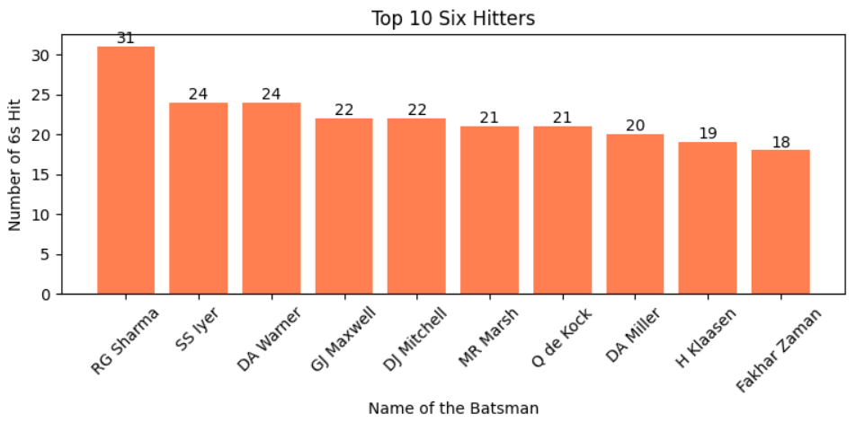
TOP TEN 6 HITTERS
Analysis: Rohit Sharma hit the maximum sixes in the tournament (31).
© Project made & presented by: Krrish Madaan

Slide 7
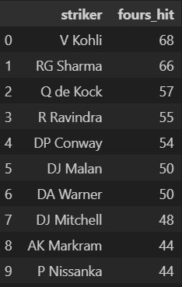
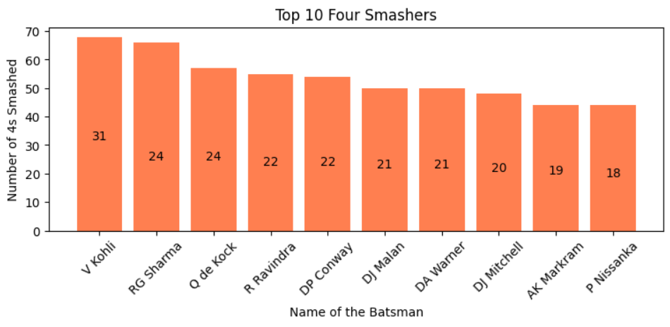
TOP TEN 4 SMASHERS
Analysis: Virat Kohli smashed the maximum fours in the tournament (31).
© Project made & presented by: Krrish Madaan

Slide 8
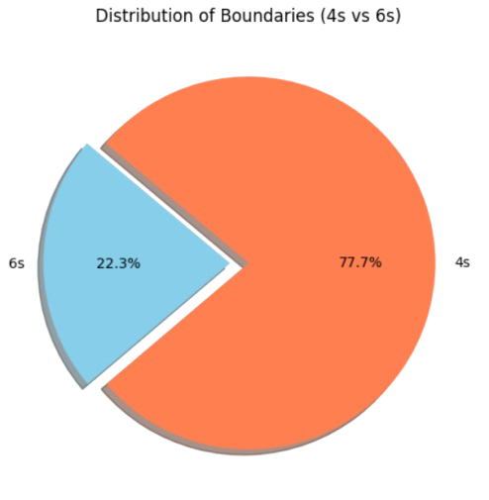

BOUNDARY DISTRIBUTION (4S V/S 6S)
Analysis: Fours (77.7%) dominate over sixes (22.3%), showing a preference for ground strokes over power-hitting amongst the batters.
© Project made & presented by: Krrish Madaan

Slide 9
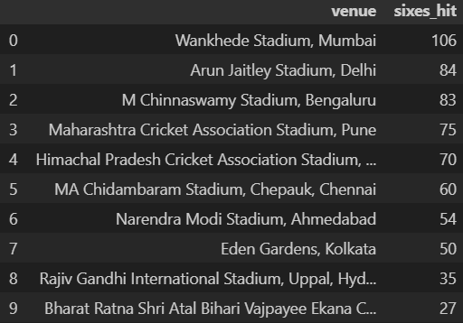
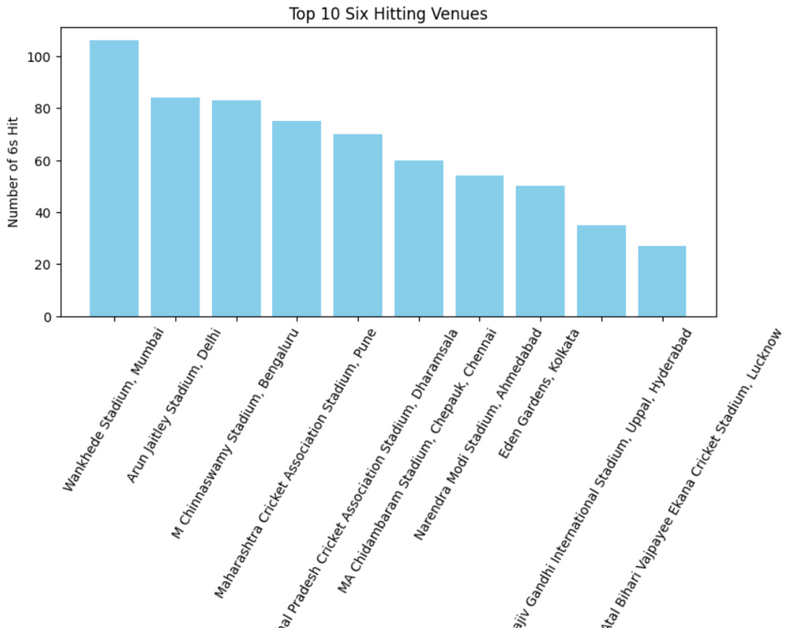
TOP TEN 6 HITTING VENUES
Analysis: Wankhede Stadium, Mumbai recorded the most 6s hit in the tournament.
© Project made & presented by: Krrish Madaan

Slide 10
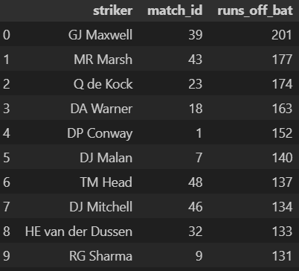
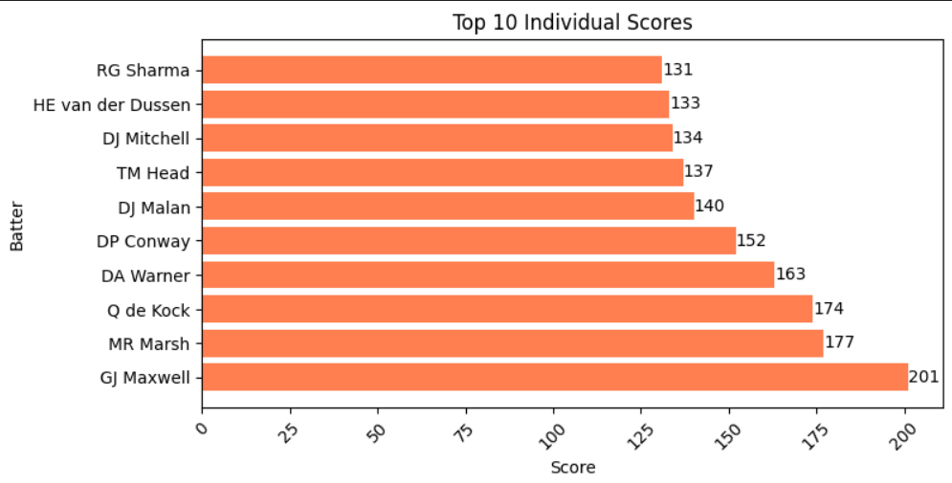
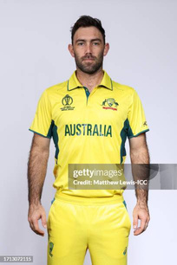
TOP TEN INDIVIDUAL SCORES
Analysis: Glen Maxwell smashed the maximum individual score in the tournament (201).
© Project made & presented by: Krrish Madaan

Slide 11
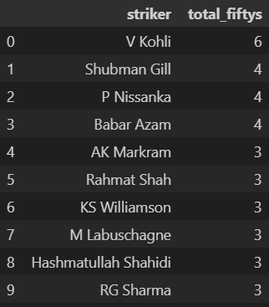
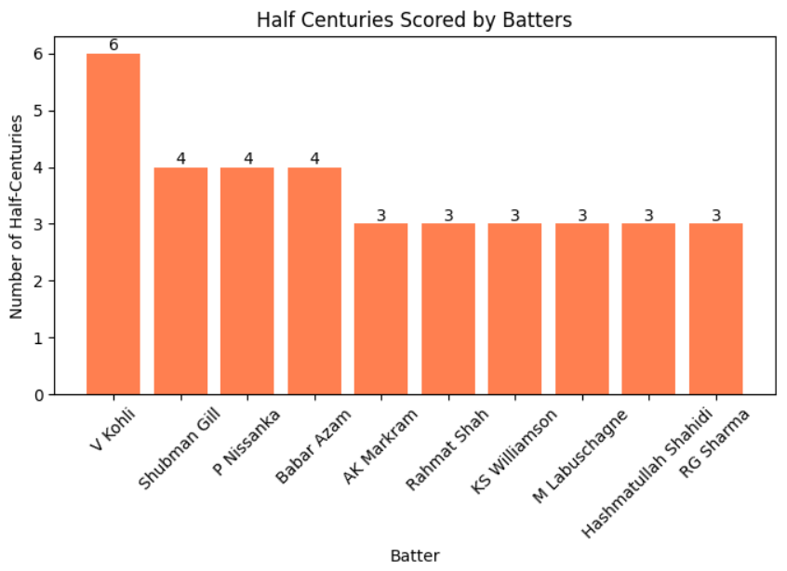
NO. OF HALF CENTURIES (TOP BATTERS)
Analysis: Virat Kohli recorded the maximum fifties in the tournament (6).
© Project made & presented by: Krrish Madaan

Slide 12
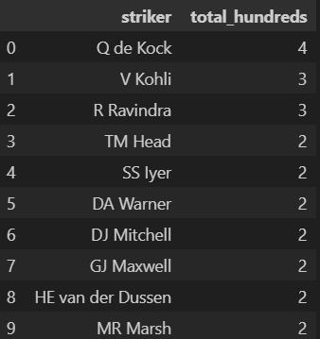
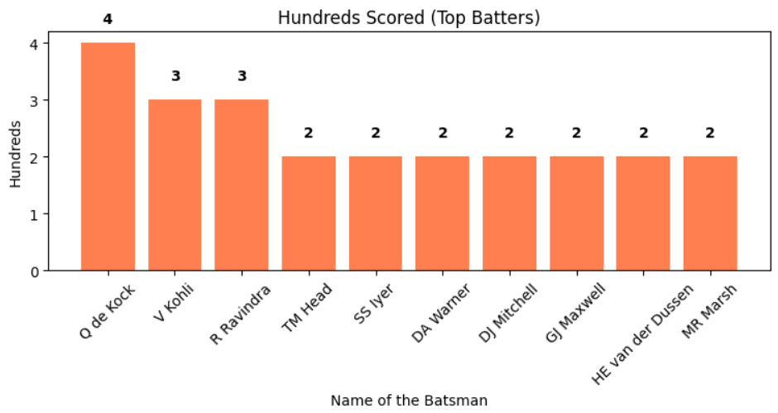
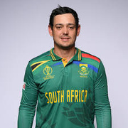
NO. OF CENTURIES (TOP BATTERS)
Analysis: Q De Kock recorded the maximum hundreds in the tournament (4).
© Project made & presented by: Krrish Madaan

Slide 13
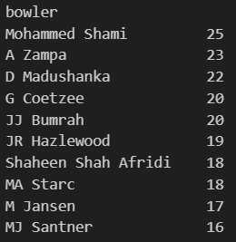
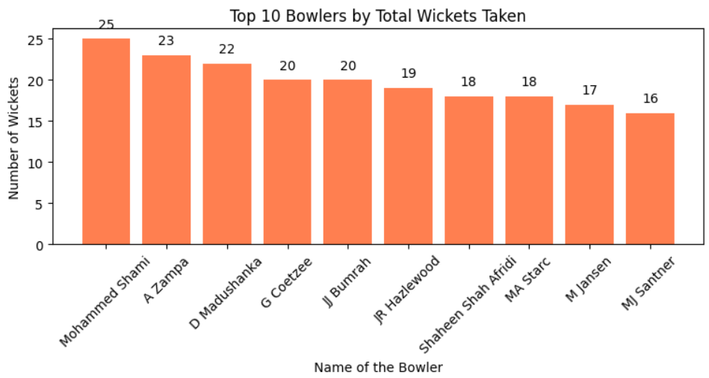
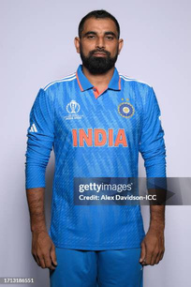
TOP 10 BOWLERS (BY WICKETS TAKEN)
Analysis: M Shami clinched the most wickets in the tournament (25).
© Project made & presented by: Krrish Madaan

Slide 14
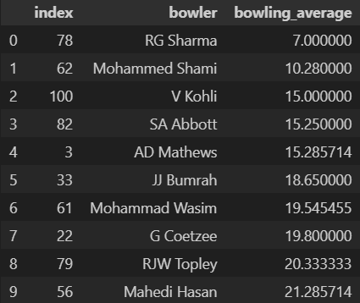
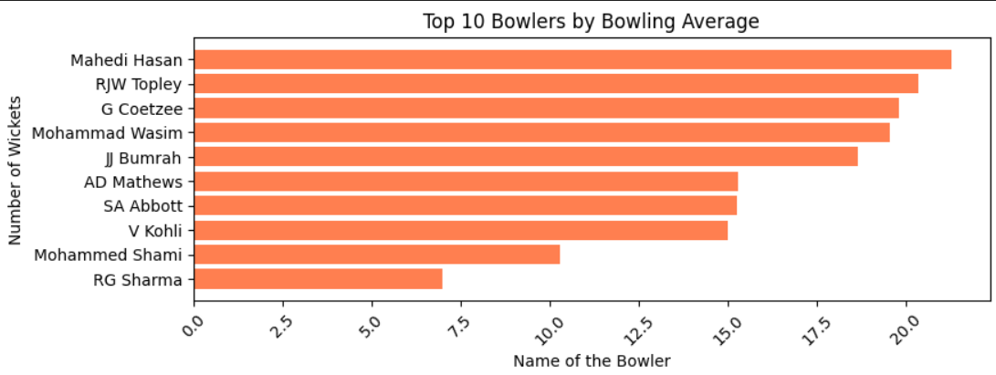
TOP 10 BOWLERS (BY BOWLING AVERAGE)
Analysis: Statistically, Rohit Sharma has the lowest bowling average. However, he's a part-time bowler so we can't consider him. As per my analysis, M Shami has the lowest bowling average.
PS: Lower the bowling average, better the bowler is performing.
© Project made & presented by: Krrish Madaan

Slide 15
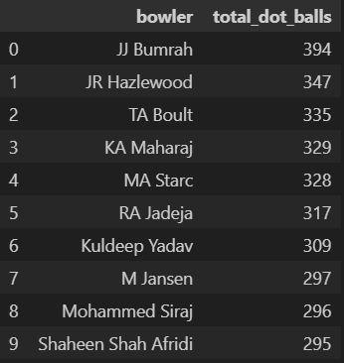
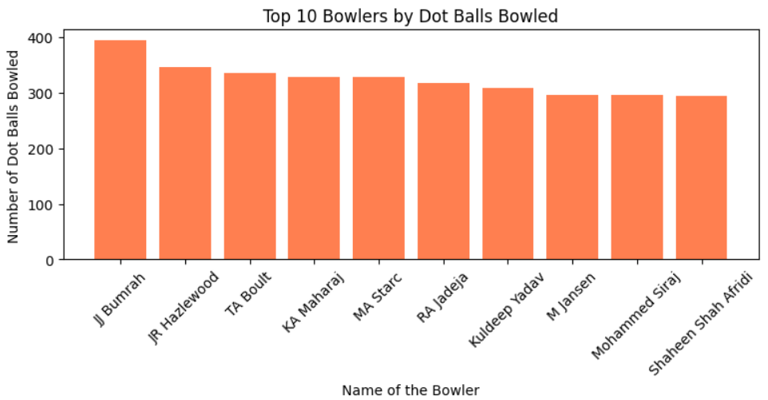
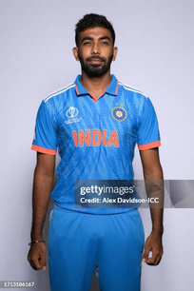
DOT BALLS BOWLED BY TOP BOWLERS
Analysis: Jasprit Bumrah bowled the maximum dot balls in the tournament (394).
© Project made & presented by: Krrish Madaan

Slide 16
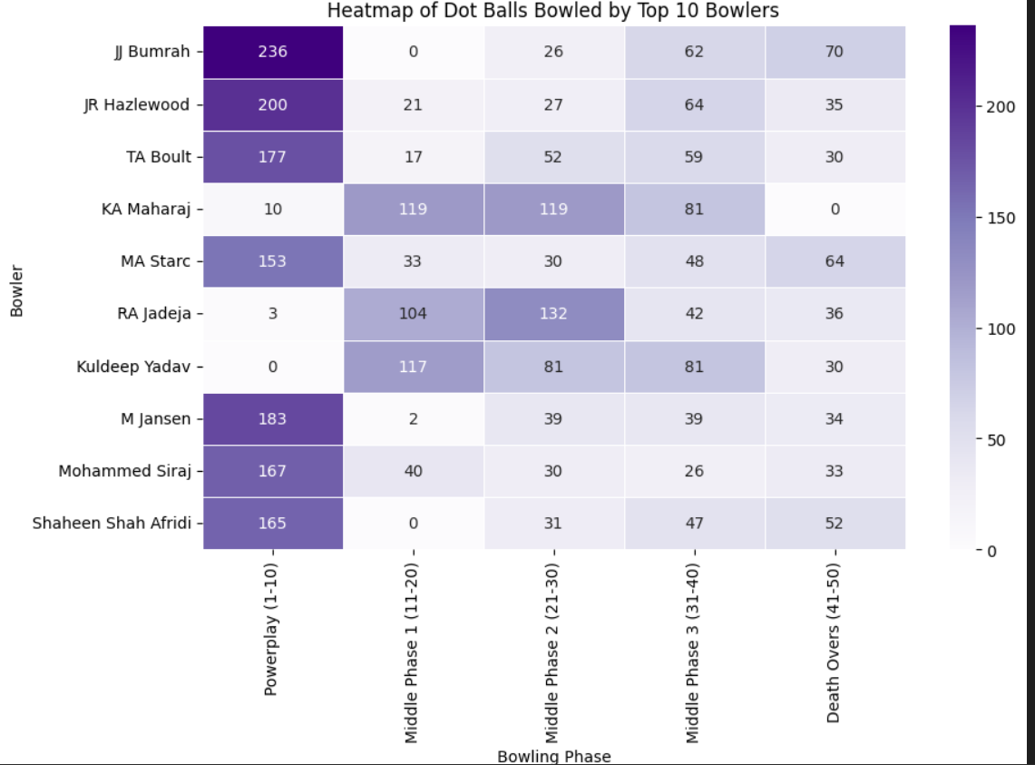
PHASE-WISE DOT BALL DISTRIBUTION AMONG TOP BOWLERS
Analysis:
1. Jasprit Bumrah bowled the most dot balls in the Powerplay (over 1-10).
2. Keshav Maharaj bowled the most dot balls in the Middle Phase 1 (over 10-20).
3. Ravindra Jadeja bowled the most dot balls in the Middle Phase 2 (over 20-30).
4. Kuldeep Yadav and Keshav Maharaj jointly bowled the most dot balls in the Middle Phase 3 (over 30-40).
5. J Bumrah bowled the most dot balls in the Death Overs (over 40-50).
© Project made & presented by: Krrish Madaan

Slide 17
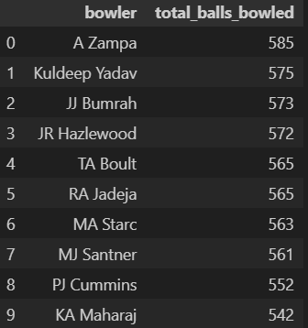
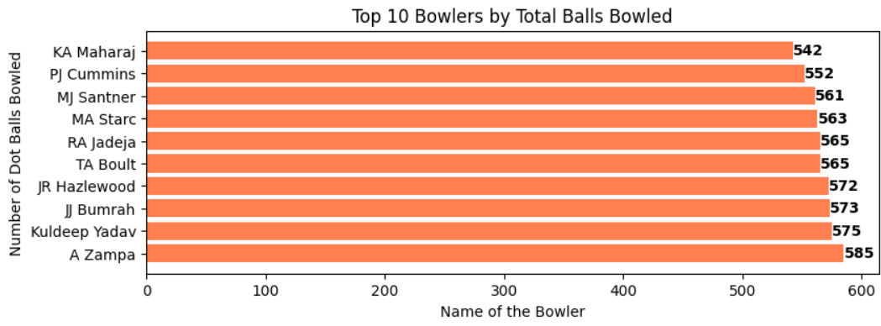
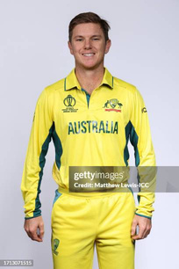
TOTAL BALLS BOWLED BY TOP BOWLERS
Analysis: Adam Zampa bowled the maximum balls in the tournament (585).
© Project made & presented by: Krrish Madaan

Slide 18
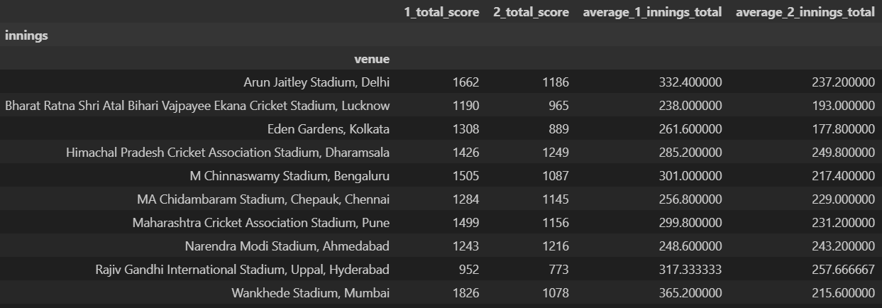
1ST AND 2ND INNINGS AVERAGE SCORE ACROSS VENUES
Analysis 1:
Highest Average 1st innings score: Arun Jaitley Stadium, Delhi
Lowest Average 1st innings score: Sh Atal Bihari Vajpayee Stadium, Lucknow
© Project made & presented by: Krrish Madaan

Slide 19
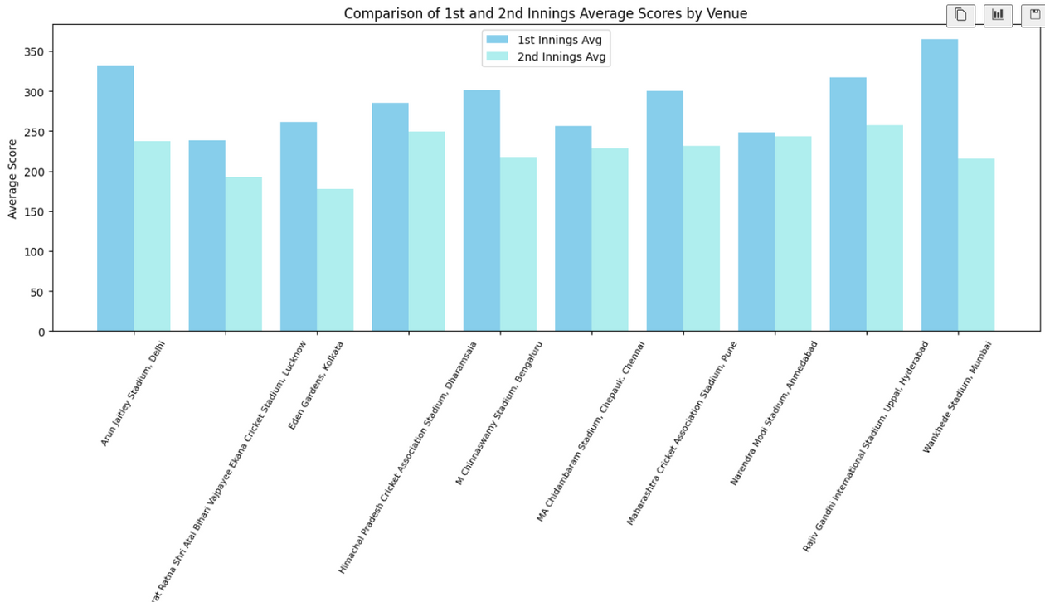
1ST AND 2ND INNINGS AVERAGE SCORE ACROSS VENUES
Analysis 2:
Highest Average 2nd innings score: Rajiv Gandhi Stadium, Hyderabad
Lowest Average 2nd innings score: Eden Gardens, Kolkata
© Project made & presented by: Krrish Madaan

Slide 20
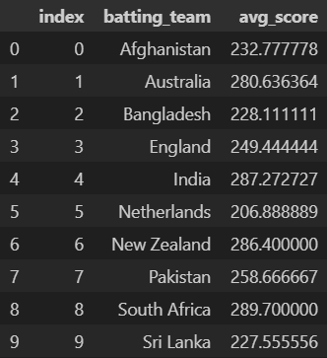
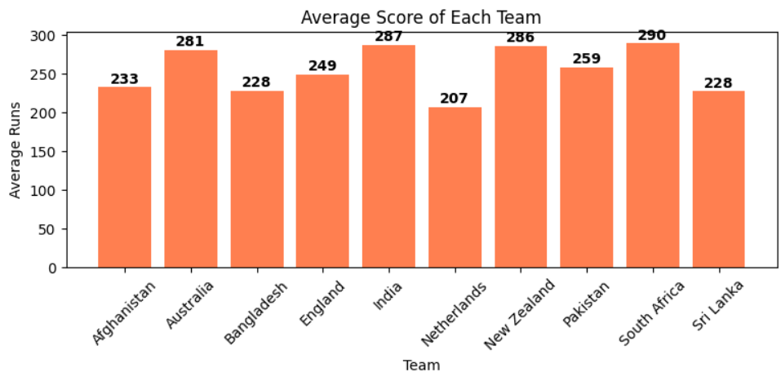


AVERAGE SCORE OF EACH TEAM
Key Analysis:
1. South Africa maintained the maximum average score at the end of the tournament.
2. The Netherlands recorded the lowest average score in this World Cup campaign.
© Project made & presented by: Krrish Madaan

Slide 21
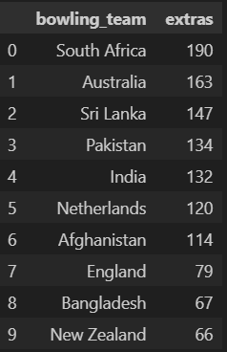
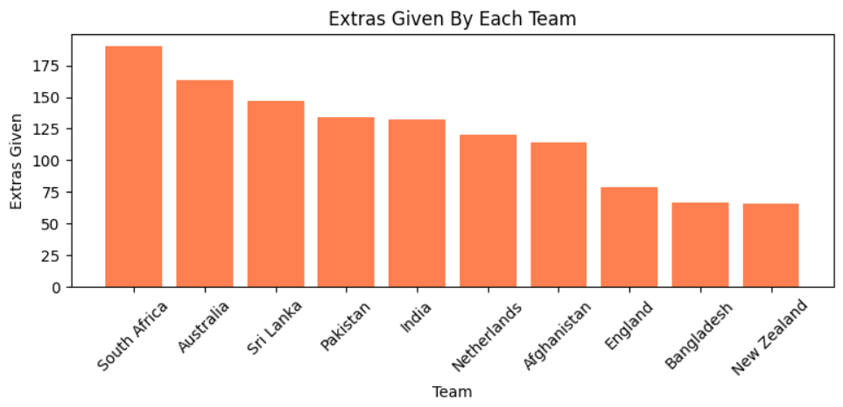

TOP TEN 6 HITTERS
Analysis:
1. South Africa leaked the most extras in the 2023 World Cup.
2. New Zealand on the other hand gave away the least extras.
© Project made & presented by: Krrish Madaan

Slide 22
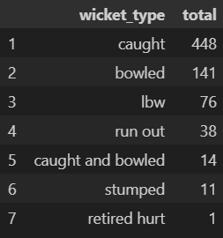
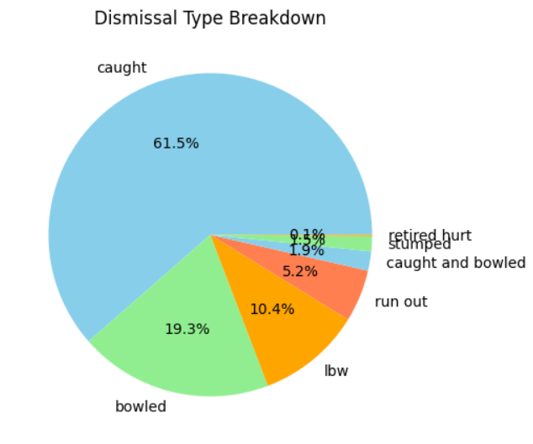
BATSMEN DISMISSAL BREAKDOWN
Analysis: Most batsmen were either caught or bowled, while only a negligible number were dismissed via stumping or retired out.
© Project made & presented by: Krrish Madaan

Slide 23
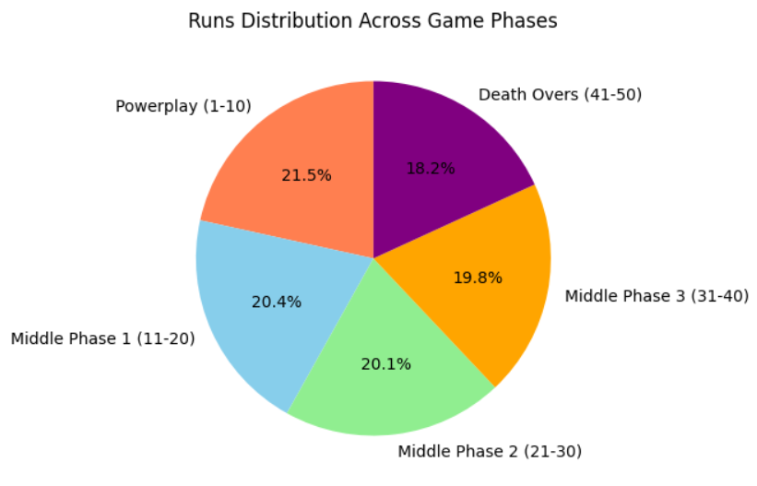
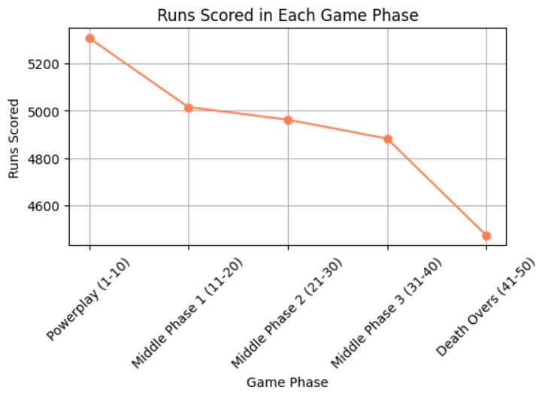
RUNS DISTRIBUTION ACROSS GAME PHASES
Analysis:
1. Maximum runs were scored in the powerplay (1-10 overs) in the tournament.
2. The least amount of runs were leaked in the death overs (41-50).
© Project made & presented by: Krrish Madaan

